Slide 1
SRI KRISHNA COLLEGE OF TECHNOLOGY
Project Design
Team Name : FoodieHexa
Arjun karthic V S
Aruna R
Madhushree R
Aparna M K
Gokul P
Balamurugan S

Slide 2


Slide 3

Back

Slide 4
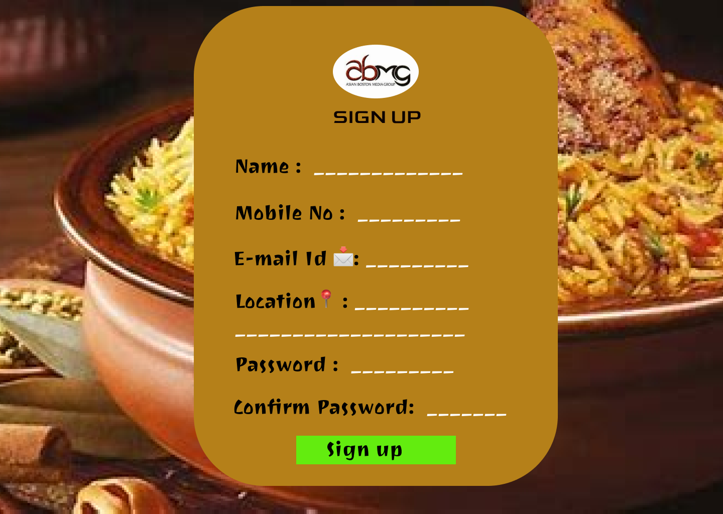

Slide 5


Slide 6


Slide 7


Slide 8
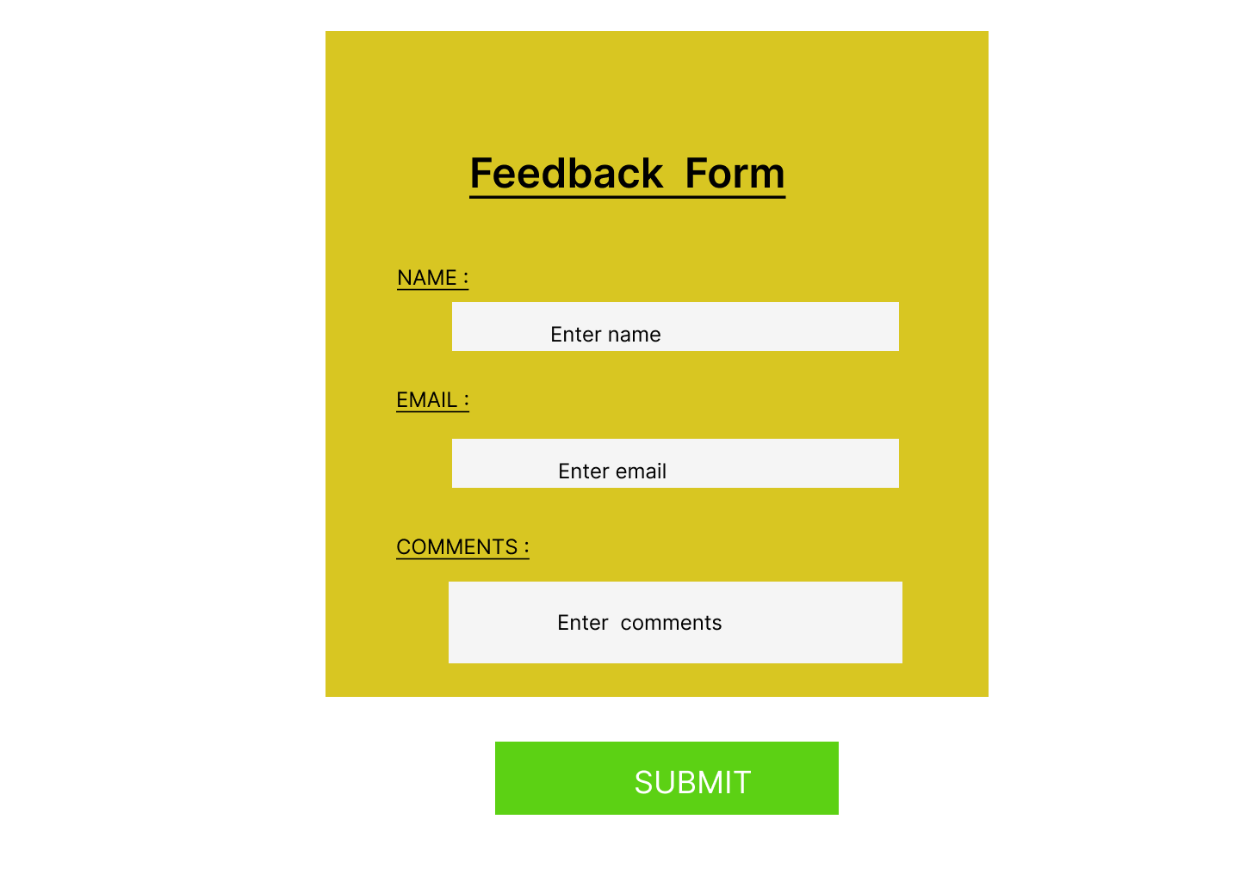

Slide 9
Import java.util.Scanner; class Main { public static void main(String args[]) { System.out.println(“Thank you”); } }
Github link: @https://github.com/arjunkarthic?tab=projects
figma link: @https://www.figma.com/file/nstMQP6sttVxlnnVkpgoyP/Untitled?node-id=0%3A1

